Slide 1
Chronic Kidney Disease (CKD)
Bruno Martínez Gutiérrez

Slide 2
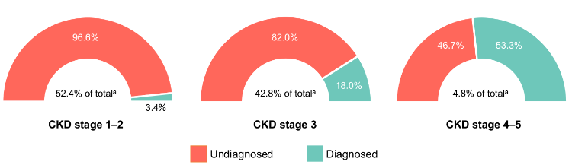
Definition and importance of CKD
CKD is defined as abnormalities of kidney structure or function, present for > 3 months, with implications for health.
In 2017, the global prevalence of CKD was 9.1% (697.5 million cases)
Mean annualized all-cause costs increased exponentially with advanced stages, from $7537 (no CKD) to $76,969 (CKD stages 4-5)

Slide 3
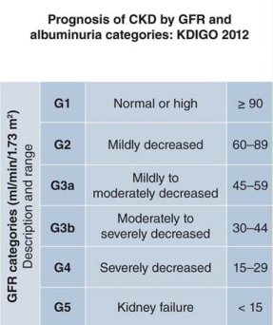
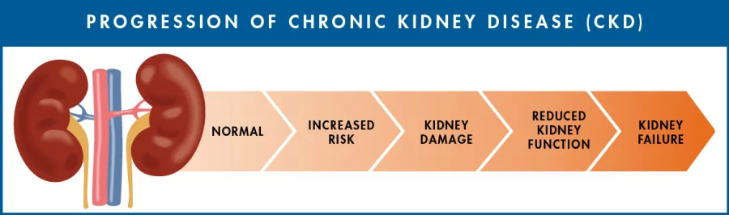
Progression in CKD
Progression: Decline in GFR Category Rapid
When a patient decline in GFR of more than 5 units per year its defined as rapid progression.

Slide 4

Benefits of detecting CKD early and prevent progression:
Gives longer life expectancy
Lower costs of treatment in early stages of the disease
Notes:
The importance of predict ckd progress resides

Slide 5

Characteristics of the dataset
300 Patients
Longitudinal data: creatinine, DBP, SBP, HGB, glucose, LDL, administrated meds
Clinical non longitudinal data: race, gender, age
Target: Progress or not in CKD stage

Slide 6

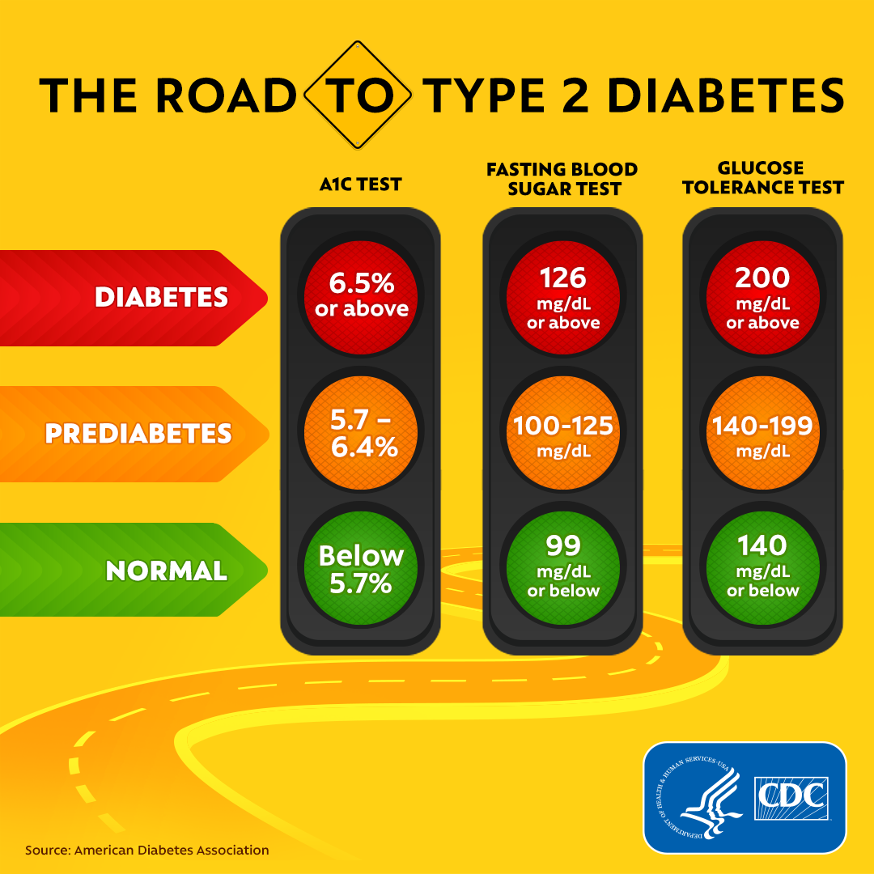

Feature Engineering
GFR level was calculated using demographic data and
creatinine levels based on the guidelines:
κ is 0.7 for females and 0.9 for males, α is -0.329 for females and -0.411 for males
Diabetes classification (Diabetes, pre-diabetes, no diabetes) using the glucose measurement

Slide 7
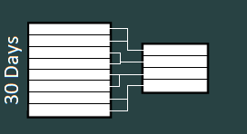
Processing the longitudinal data
A time windows was used to deal with disadvantages of longitudinal data.
The time series were collapsed on a time frequency of 30 days
This value was selected to maximize the number of data for each patient

Slide 8
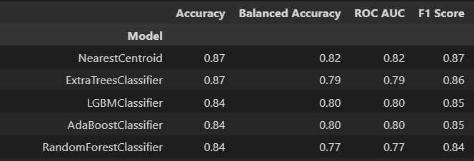
Modelling
Modelling using the 27 most common supervised classification models
Selected the top 5 models based on the F1 score as it considers both precision and recall

Slide 9
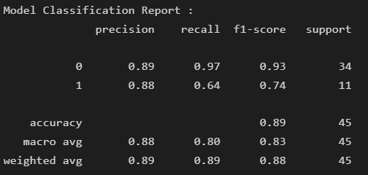
Modelling
Selected model: Random forests, with an F1 score of 87%
Precision: Out of all the patients that the model predicted would get progress, only 88% actually did. On the other hand, 89% of the time the model predict correctly if a patient will not progress.
Recall: Out of all the players that actually progress, the model only predicted this outcome correctly for 64% of those patients. For the patients that did not progress, the model got it right 97% of the time.

Slide 10
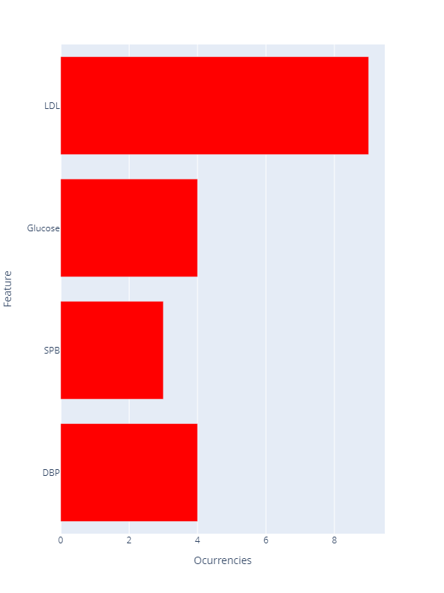
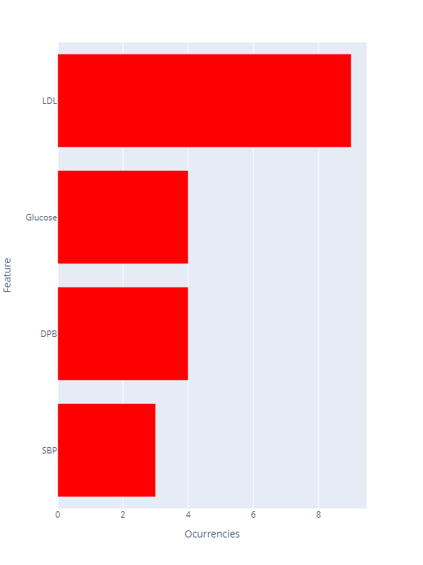
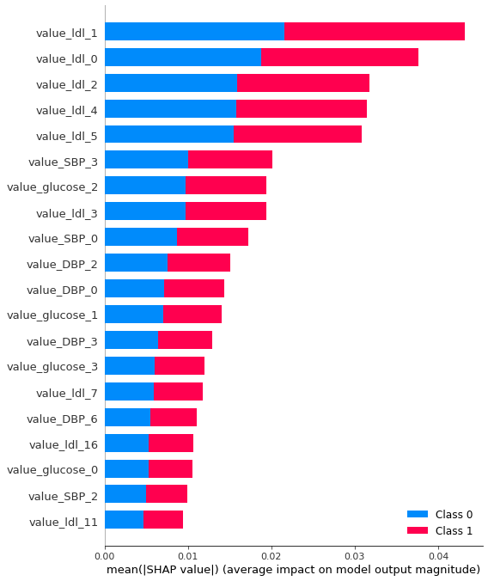
Results
Occurrences in the top 20 most important variables
Measurements per time window

Slide 11
Insights
LDL appears to be the most important variable to predict the progression of the disease
The 4 most important variables detected by the model are associated with multiple chronic degenerative diseases such as hypercholesterolemia, diabetes, metabolic syndrome and hypertension
The presence of the above comorbidities increases the risk of progression.

Slide 12
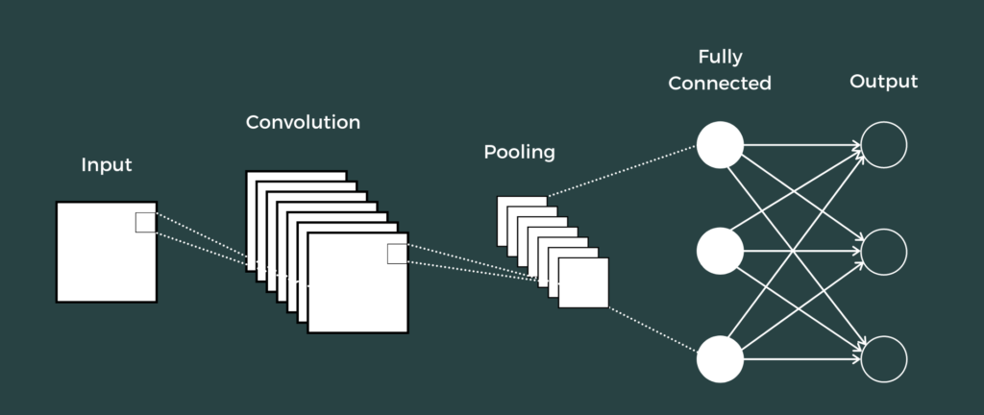
Improvements to the model
Some patients do not have too much longitudinal data (i.e 200 days), we can model features per patients (glucose, LDL) to predict the values in the future, so we have more data
With more data, complex DL models can be used, such as an convolutional neural networks
Infer comorbidities based in the clinical features

Slide 13

Thanks for your attention

